Slide 1
Control Upset Prevention & Recovery (CUPR)
NASA Langley
-Subhabrata Ganguli
Others: Sonja Glavaski, George Papageorgiou, Mike Elgersma
NASA COTR: Pat Murphy

Slide 2
Charter - Tasks
Priority
P1
Replace backdrive.mdl (read related email)
Design pilot tasks amenable to Cooper-Harper Rating
Conduct Simulation Test Sets 1 & 2. If detection performance is ok, conduct Test Sets 3 & 4
Validate “Detection_Model” using B757 aero & engine models
Investigate whether one aileron basis function is sufficient to obtain desired FDIR performance. Verify kernel injection
After tuning the CUPRSys algorithm, repeat Task 3.
P4
P2
P3
P3
P3

Slide 3
Task 3
TASK 3
Conduct Simulation Test Sets 1 & 2.
If detection performance is ok, conduct Test Sets 3 & 4

Slide 4
Thought Process Map
Clear definition of Test Sets 1 to 4?
  See CUPRSystestscenarios.doc
    Test 1: Baseline Control Law and Fault Detection
    Test 2: + Single Aircraft Failures
    Test 3: + Fault Isolation with Signal Injection
    Test 4: + Control Law Reconfiguration
  How to run simulation?
    MATLAB >> setup. Follow GUI.
    Familiarize. Online help available. Ask others.
    What outputs should I look at? See IDplotting.m
    What are the Simulink changes to change from Sets 1 to 4.
What is the measure of detection performance?
  ID_flag should correcpond to faults

Slide 5
Simulation Results
Flight Condition: Boeing_541
(h=3000ft, Mach = 0.35)
Small Amplitude Doublets (30 sec duration):
1 deg phi (20 sec), 1 deg theta (60 sec) , 2 ft/s v (100 sec)
Large Amplitude Doublets (30 sec duration):
5 deg phi (20 sec), 5 deg theta (60 sec) , 10 ft/s v (100 sec)

Slide 6
No Faults

Slide 7
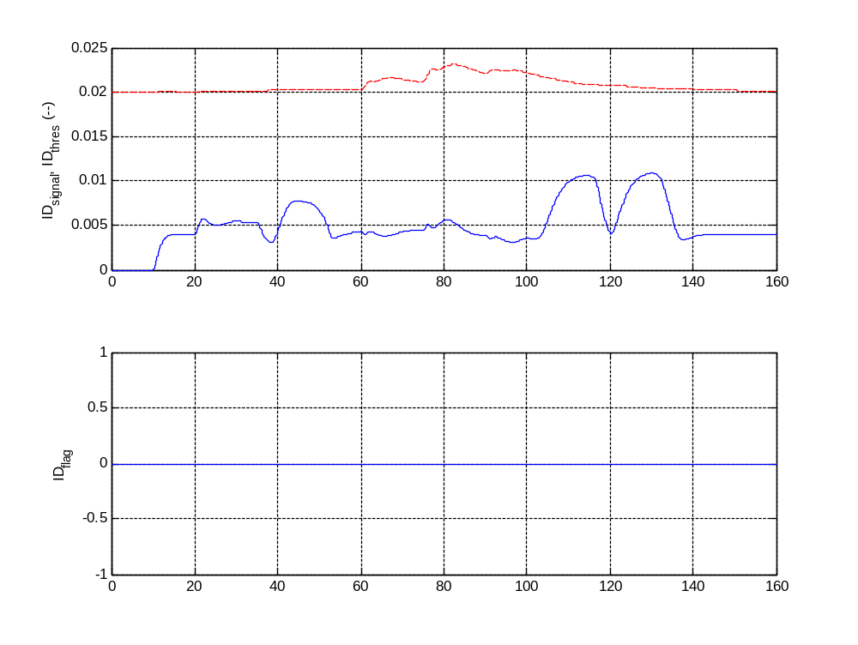
No fault – small amplitude

Slide 8
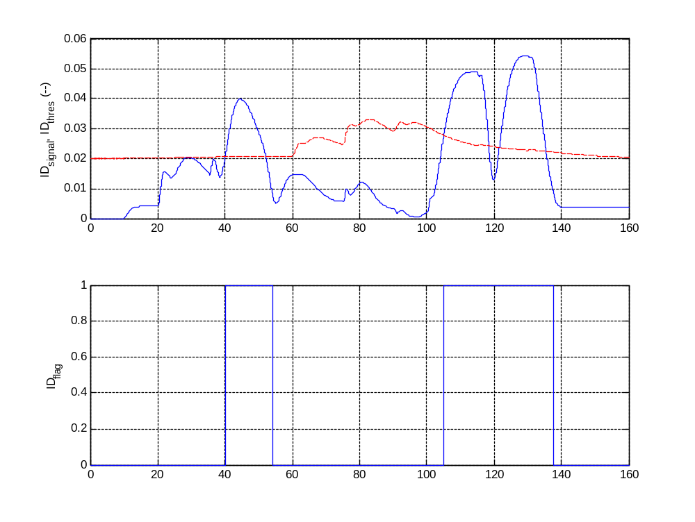
No fault – large amplitude

Slide 9
Faults

Slide 10
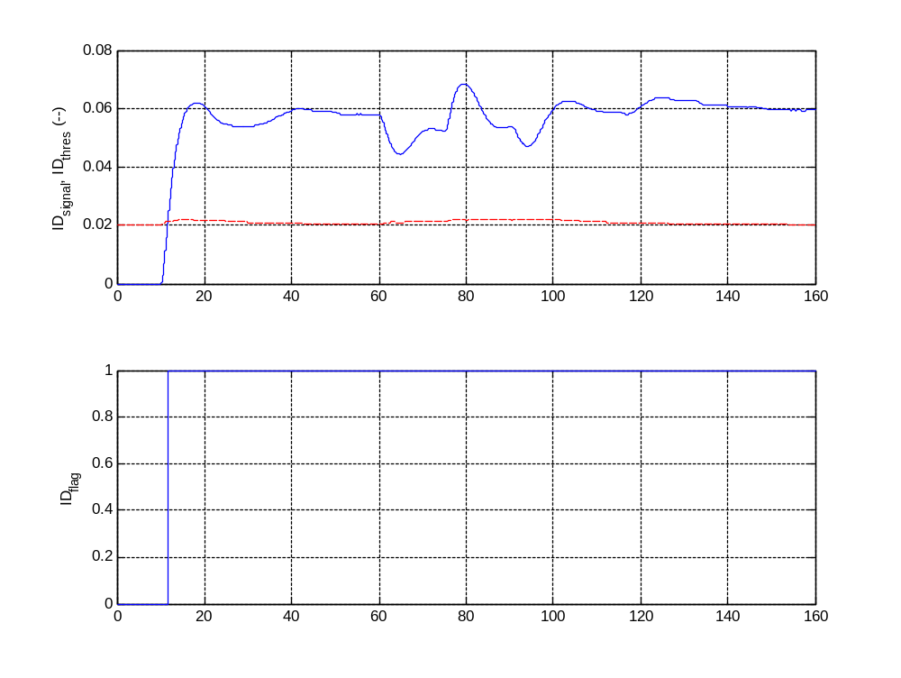
50% Elevator fault – small amplitude

Slide 11
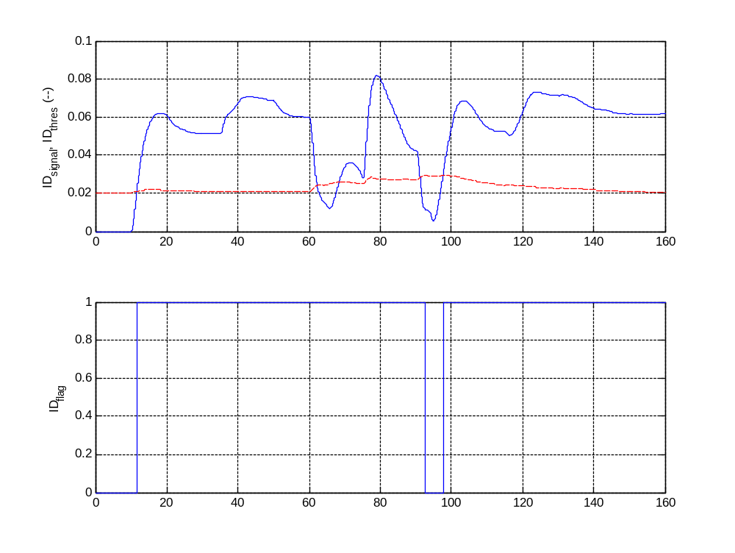
50% Elevator fault – large amplitude

Slide 12
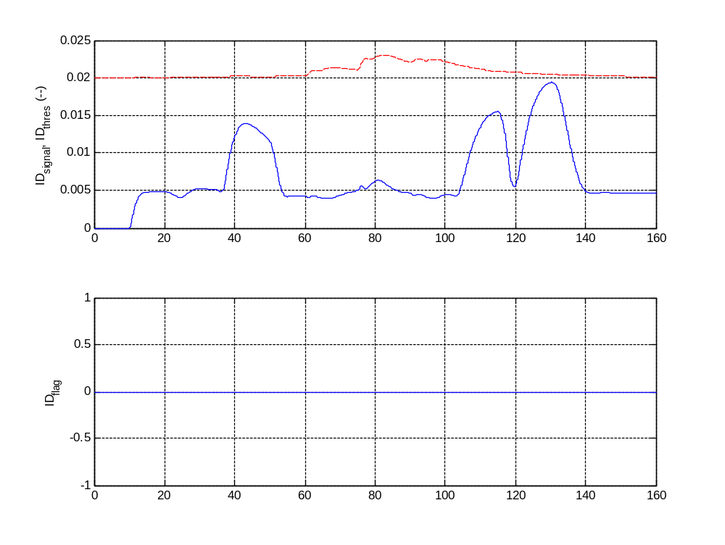
50% Aileron fault – small amplitude

Slide 13
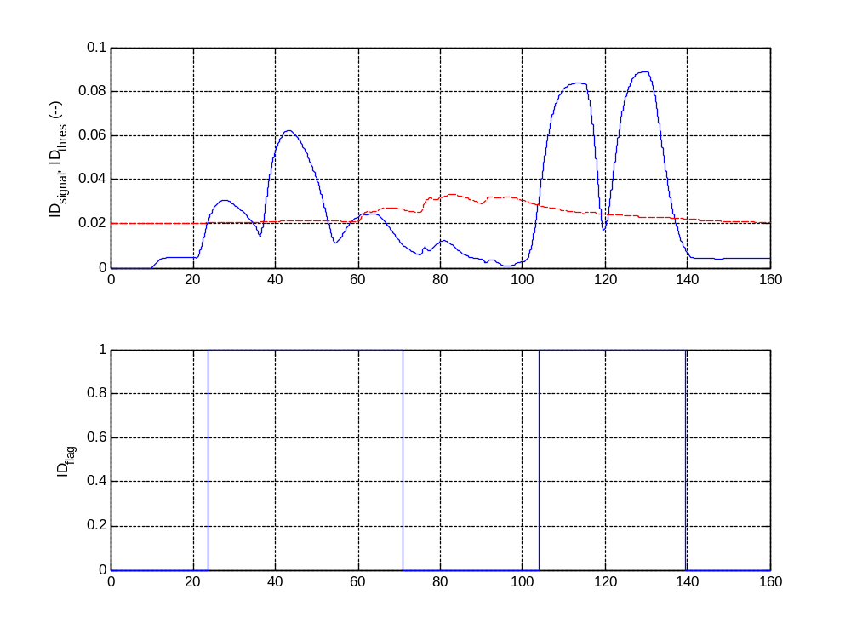
50% Aileron fault – large amplitude

Slide 14
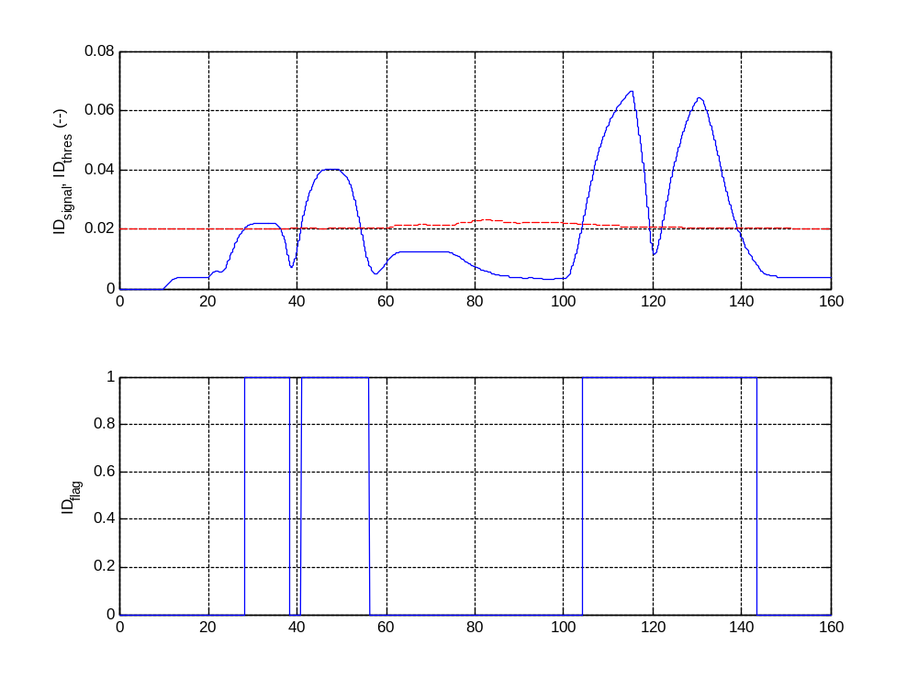
50% Rudder fault – small amplitude

Slide 15
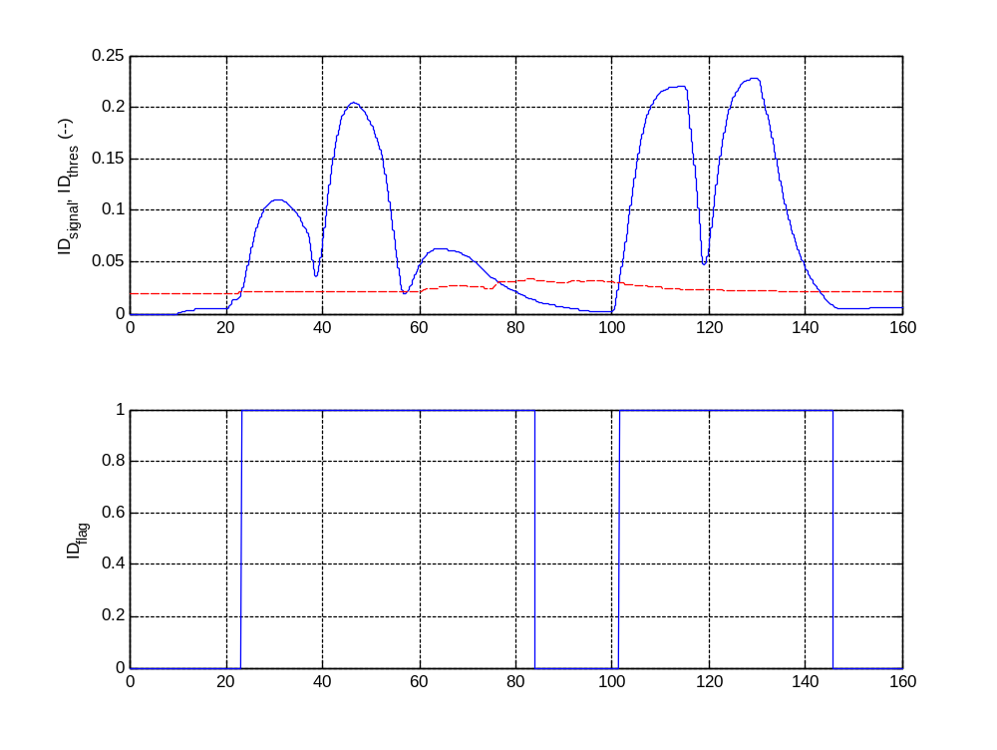
50% Rudder fault – large amplitude

Slide 16
Detection Model Validation

Slide 17
No fault – small amplitude

Slide 18
No fault – large amplitude

Slide 19
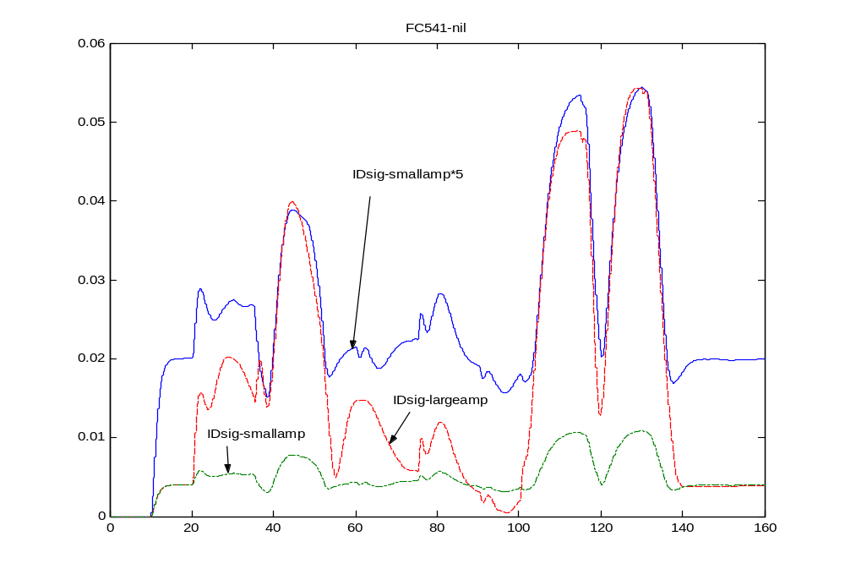
Comparison – ID_sigs

Slide 20
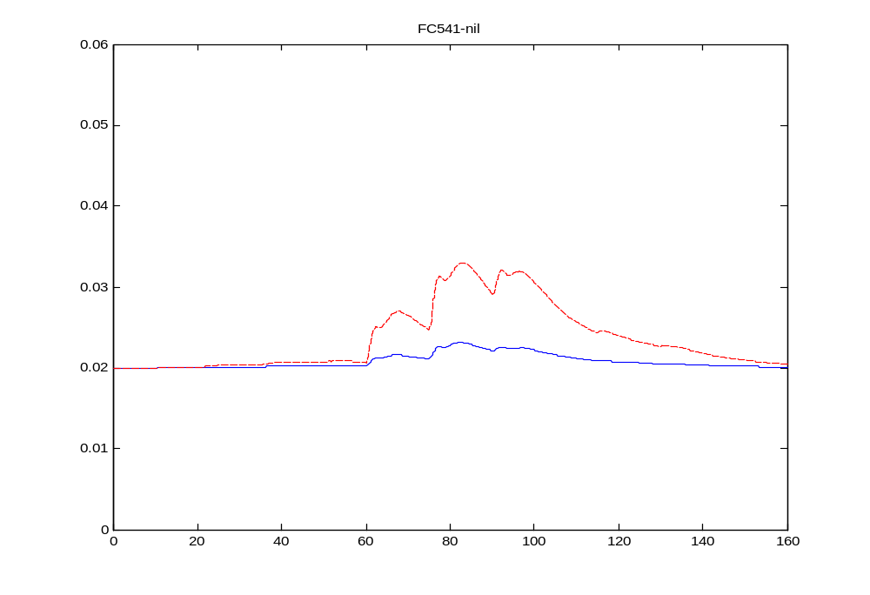
Comparison – ID_threshold

Slide 21
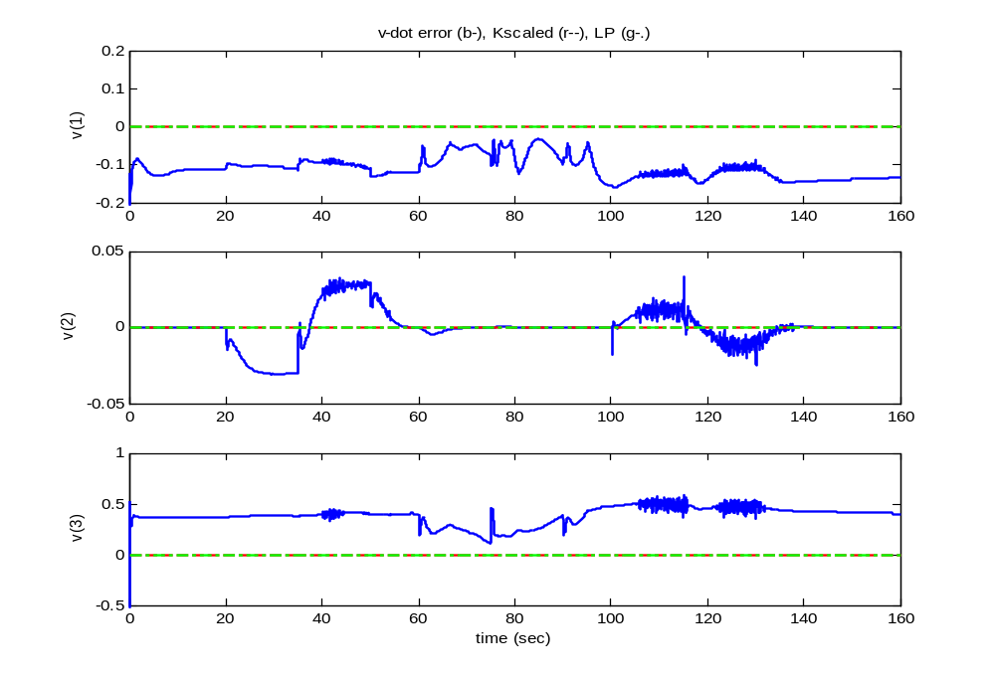
v-errors (ft/s)

Slide 22
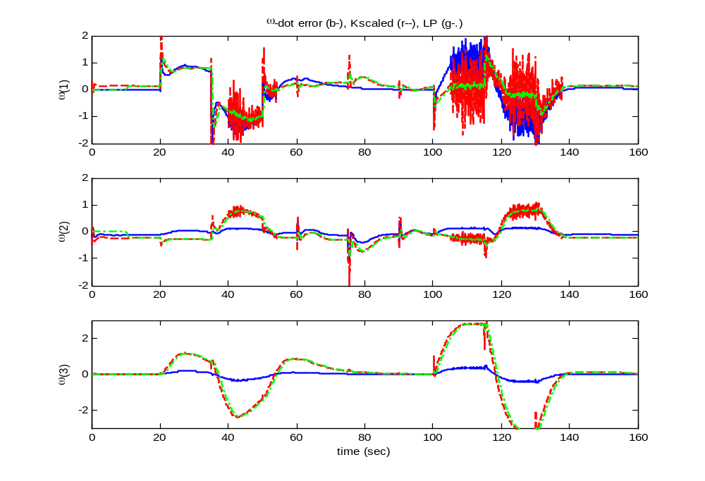
w-errors (deg/s)

Slide 23
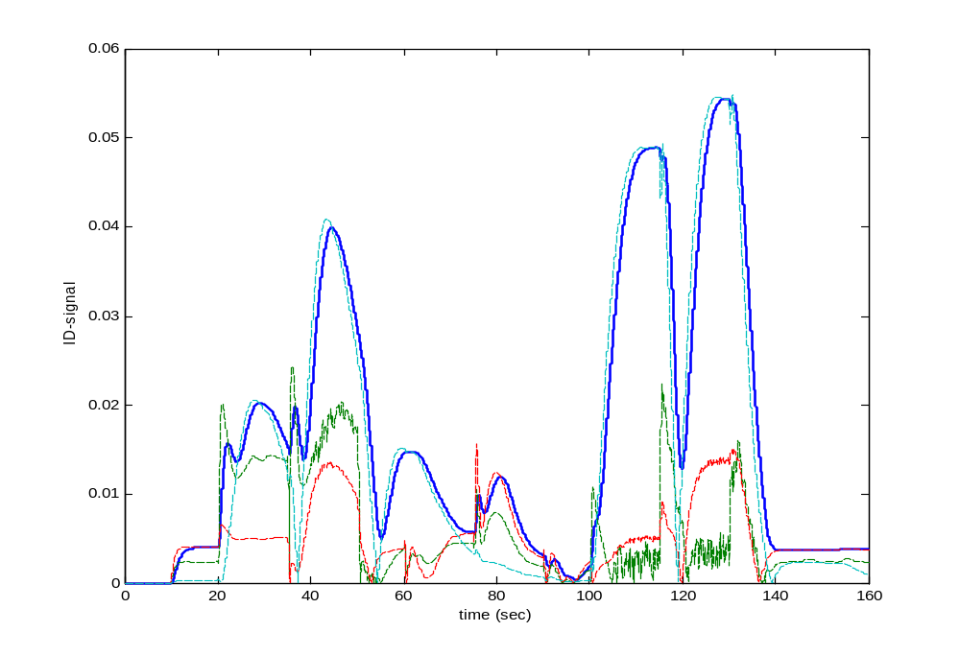
ID_sig + components (before second LP)

Slide 24
No Fault – Boeing 451

Slide 25
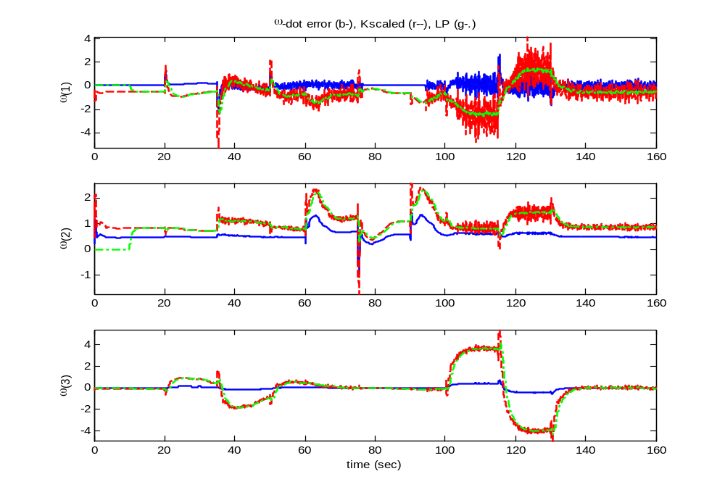
w-errors (deg/s)

Slide 26
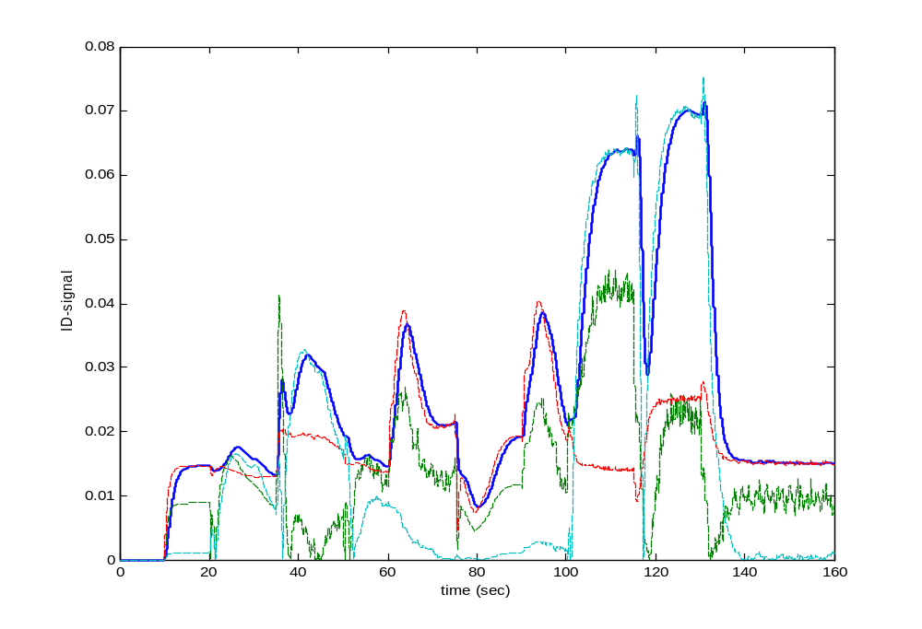
ID_sig + components (before second LP)

Slide 27
No Fault – default trim

Slide 28
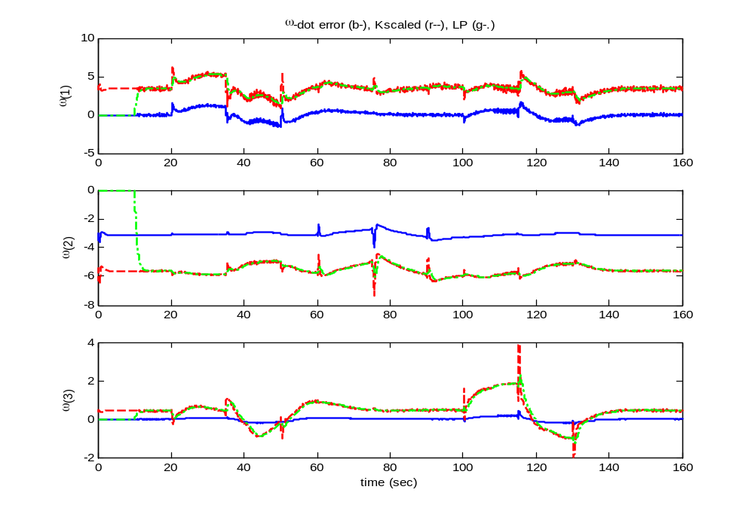
w-errors (deg/s) – default trim

Slide 29
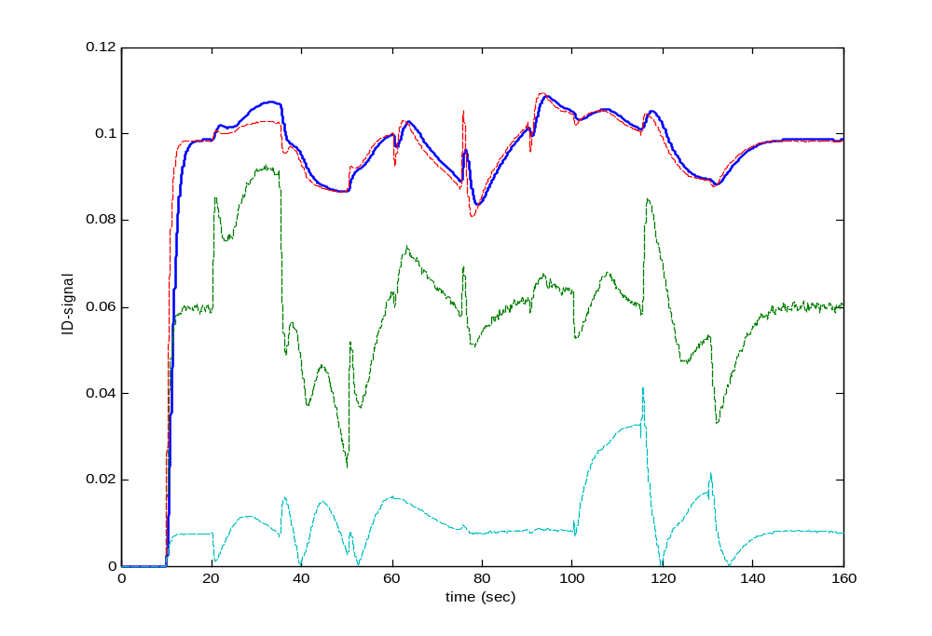
ID_sig + components (before second LP)

Slide 30
Conclusion
It seems K-scale is not doing anything good for any of the three flight conditions (Boeing 541, Boeing 451 and default_trim). This is based on comparing “debug_wdot_err” and “debug_wdot_Kscaled”.
Need to focus on “No-fault” case first – we are having false +ve.
Re-design K_scale at one FC and test on other two.
FC – “default_trim” may need special consideration because of involvement of landing gear.

Slide 31
K-scale Analysis
FC1: Boeing 541

Slide 32
K_scale
K_scale1 = K_scale*inv(B)*J
K_scale1 = diag(K1,K2)
K1 = diag(0,0,0)
K2 = [1.9470 -1.0926 -5.0079
-0.2728 1.8039 -0.6200
-0.4861 -0.1376 9.1226]
≈ [ 2 -1 -5
0 2 0
0 0 10] (approx. for analysis)

Slide 33
Rudder Failure

Slide 34
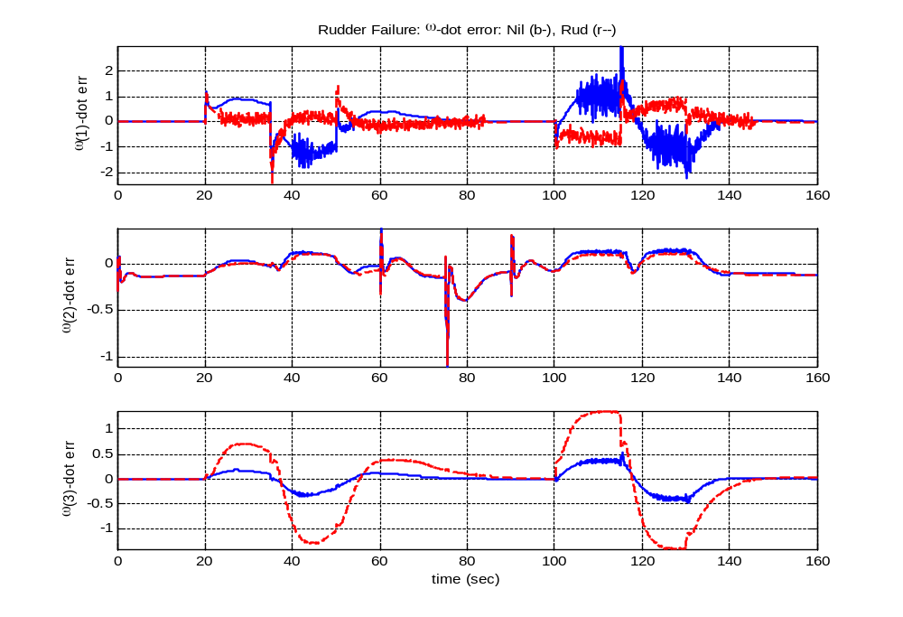
Rudder fail: w-dot error (deg/s)

Slide 35
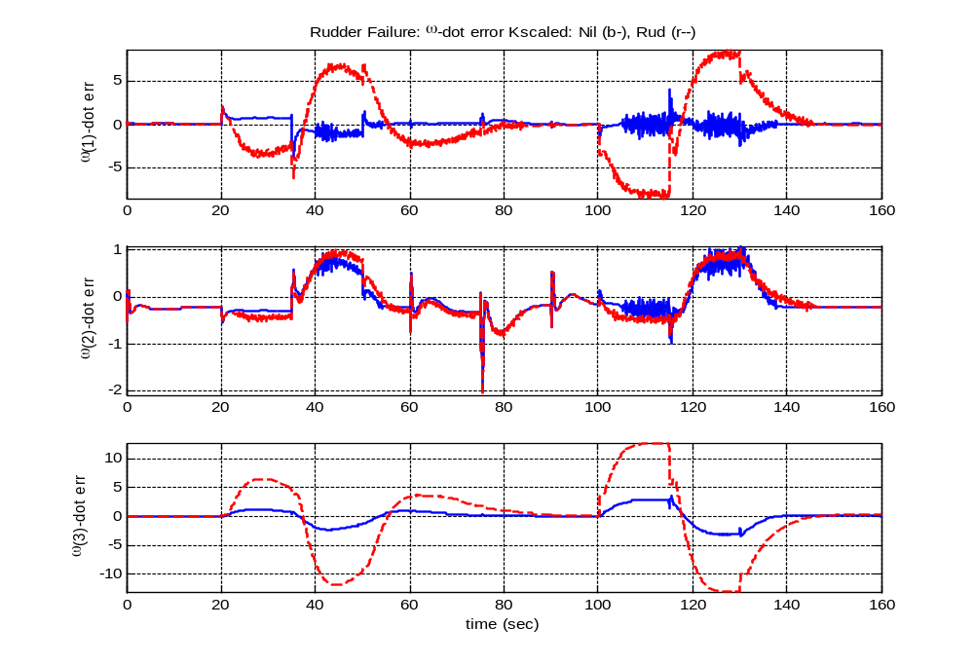
Rudder fail: w-dot error K_scaled (deg/s)

Slide 36
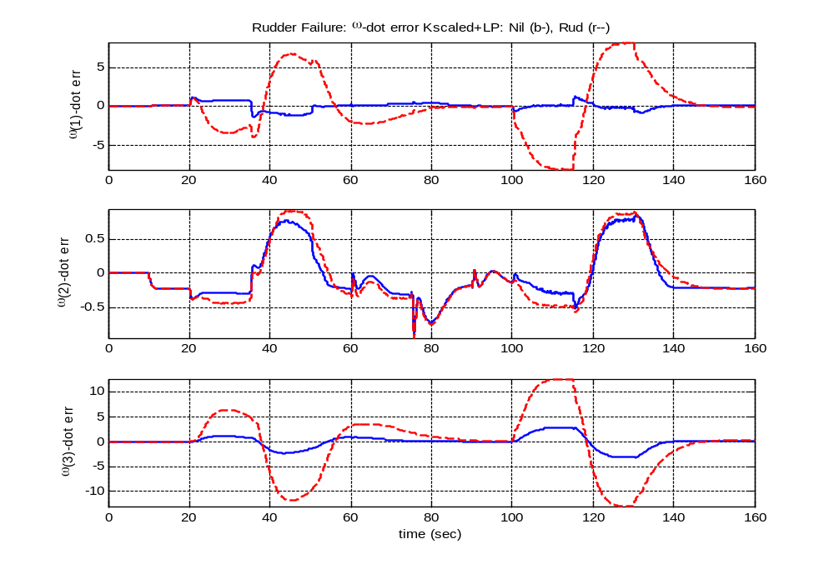
Rudder fail: w-dot error K_scaled+LP (deg/s)

Slide 37
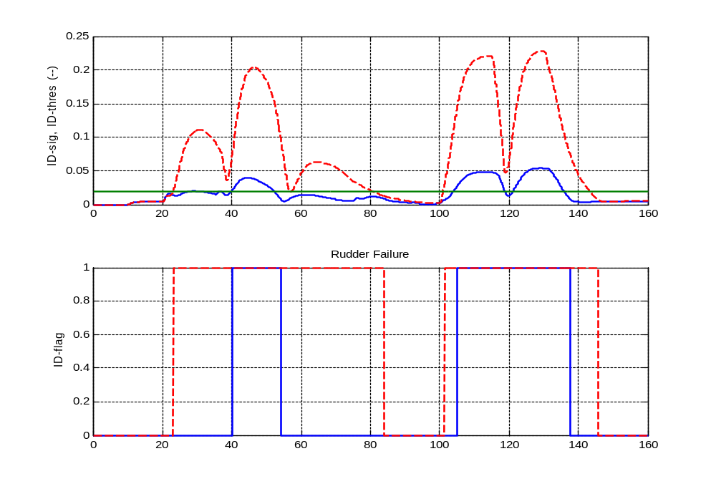
Rudder fail: ID_signal, ID_flag, ID_thres = 0.02

Slide 38
Elevator Failure

Slide 39
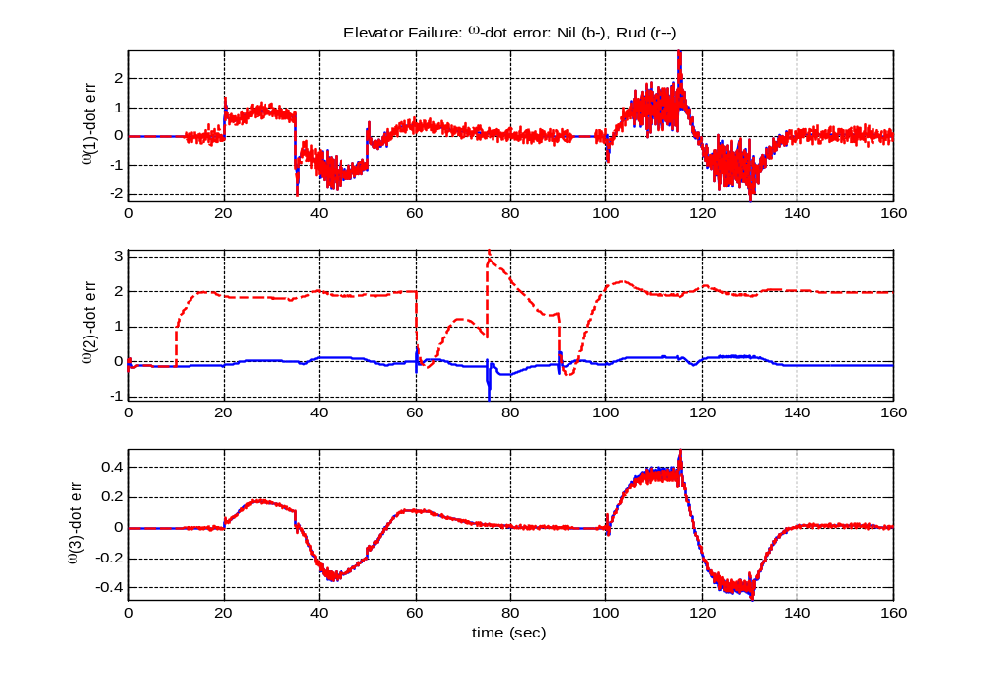
Elevator fail: w-dot error (deg/s)

Slide 40
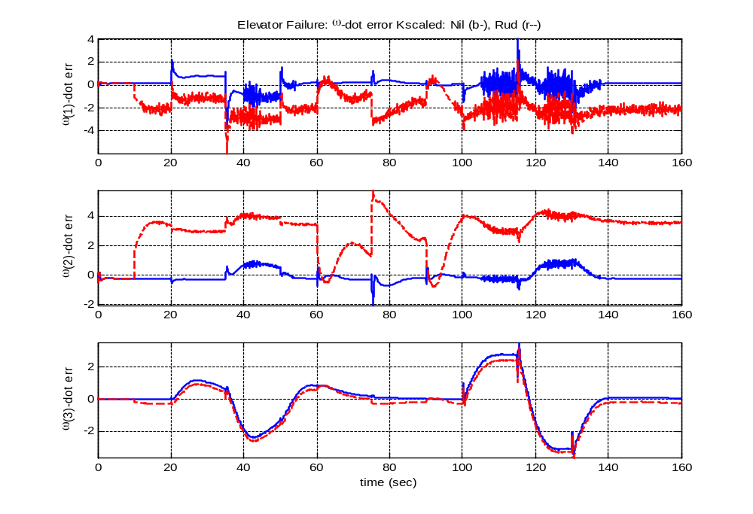
Elevator fail: w-dot error K_scaled (deg/s)

Slide 41
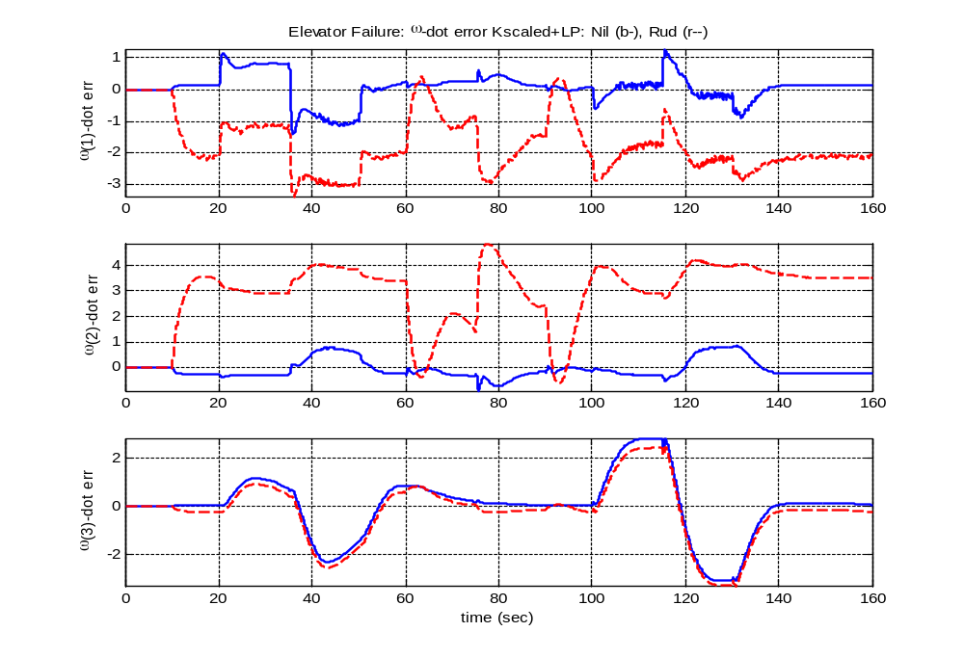
Elevator fail: w-dot error K_scaled+LP (deg/s)

Slide 42
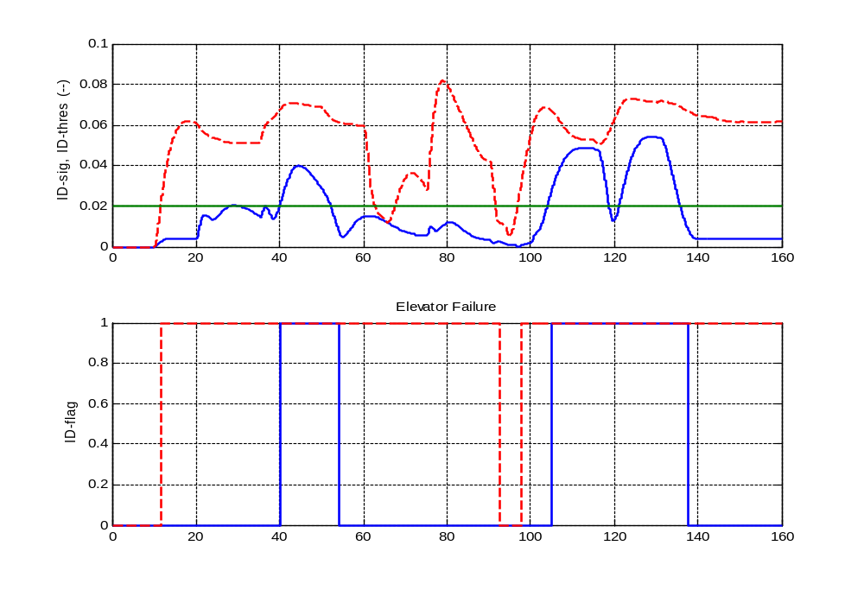
Elevator fail: ID_signal, ID_flag, ID_thres = 0.02

Slide 43
Aileron Failure

Slide 44
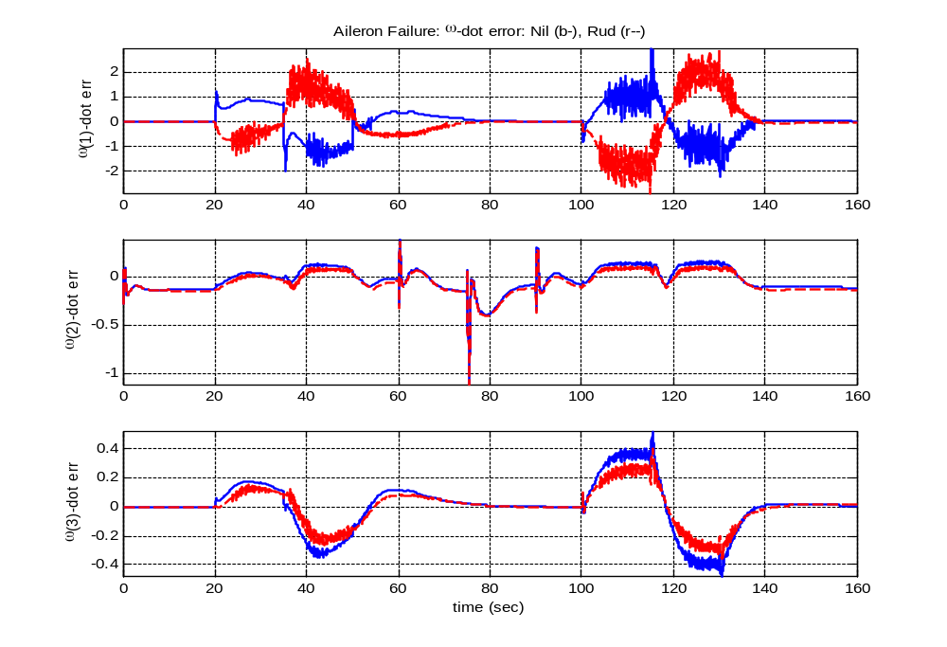
Aileron fail: w-dot error (deg/s)

Slide 45
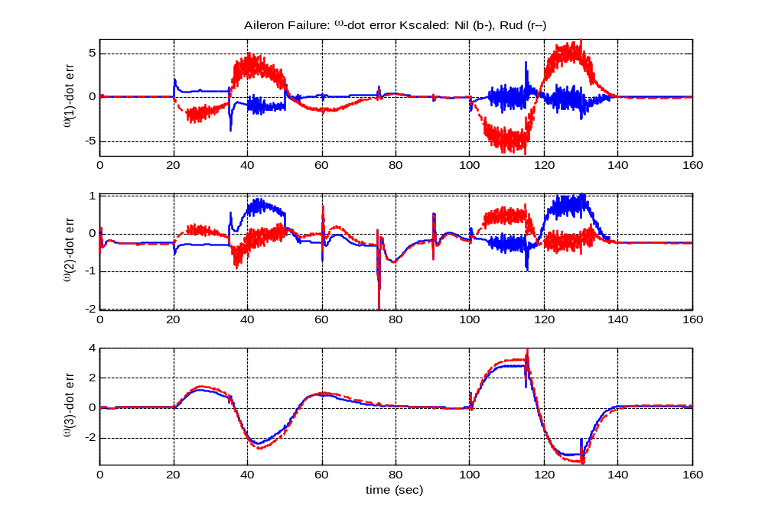
Aileron fail: w-dot error K_scaled (deg/s)

Slide 46
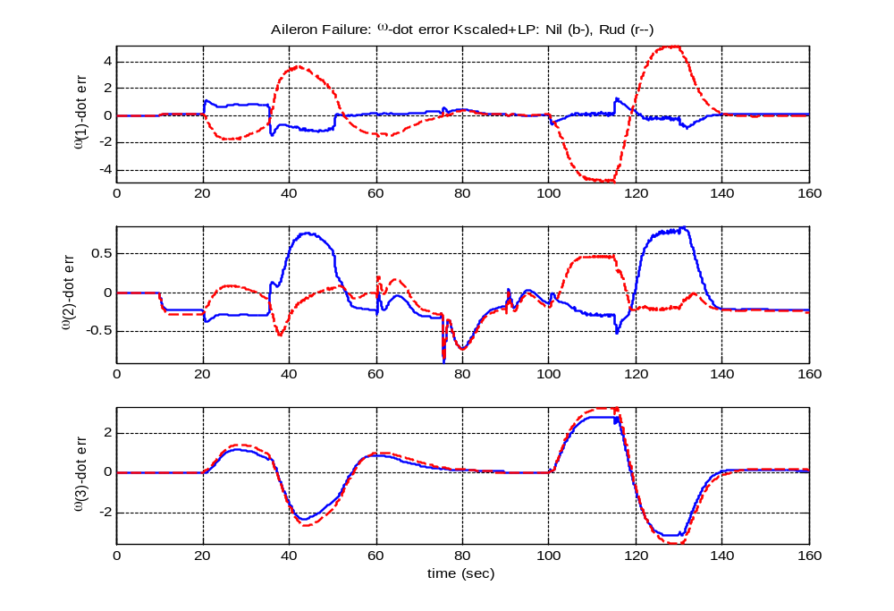
Aileron fail: w-dot error K_scaled+LP (deg/s)

Slide 47
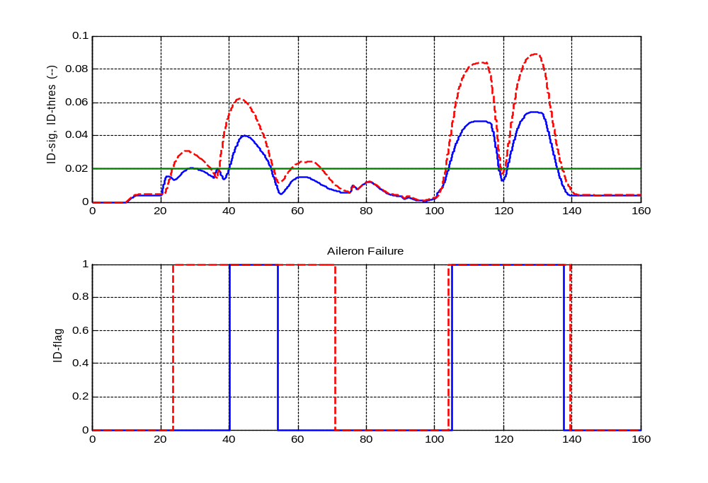
Aileron fail: ID_signal, ID_flag, ID_thres = 0.02

Slide 48
K-scale Re-design
FC1: Boeing 541

Slide 49
Re-designed K_scale
K_scale1 = K_scale*inv(B)*J
K_scale1 = diag(K1,K2)
K1 = diag(0,0,0)
K2 = [ 3 0 -9
0 2 0
-0.4 0 2]
K2_orig = [1.9470 -1.0926 -5.0079
-0.2728 1.8039 -0.6200
-0.4861 -0.1376 9.1226]

Slide 50
Basis for designing K_scale
Looked at both small and large-amp signals. Assumed ID_threshold = 0.02;
No-fault:
  Cross-coupling in p and r removed by introducing off-diagonal terms -9 and -0.4. Idea is to have effect of Ail-fail in p*, Ele fail in q*, Rud-fail in r*. [p*, q*, r*] are signals scaled by K_scale.
Fault:
  Diagonal-scales of 3, 2, 2 selected to have ID_sig > 0.02 w/ fault.
  When re-scaling diagonal terms, off-diagonal terms in corresponding row should also be re-scaled. E.g., 1st row may be [1 0 -3].
Conflict of interest between “FC1_nil_smallamp” and “FC1_ail_largeamp”.

Slide 51
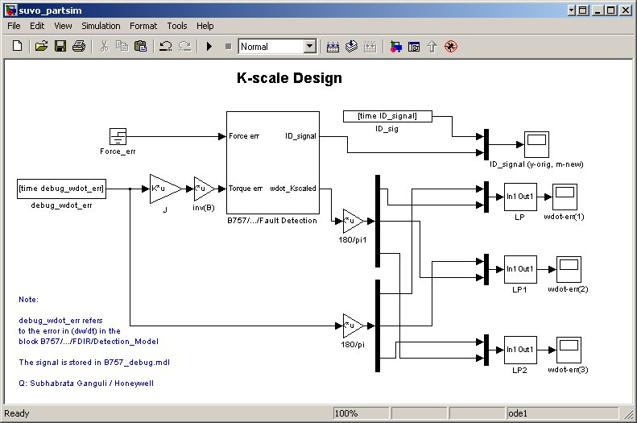
Simulink Block Diagram

Slide 52
Large Amp Inputs

Slide 53
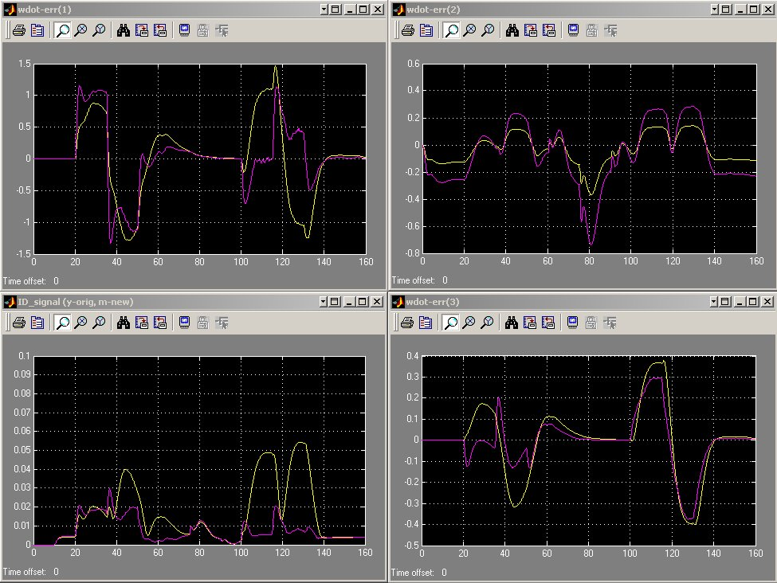
No fault: Yel – before scale, Mag – after scale

Slide 54
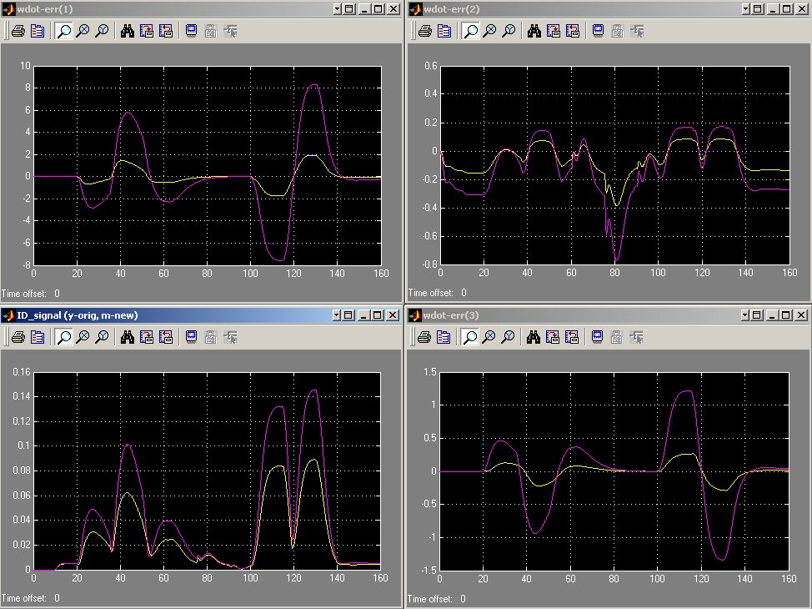
Ail fault: Yel – before scale, Mag – after scale

Slide 55
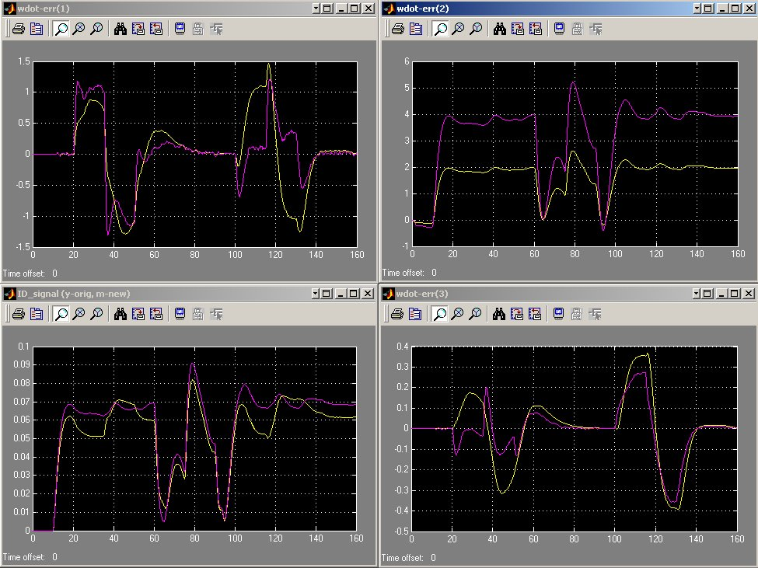
Ele fault: Yel – before scale, Mag – after scale

Slide 56
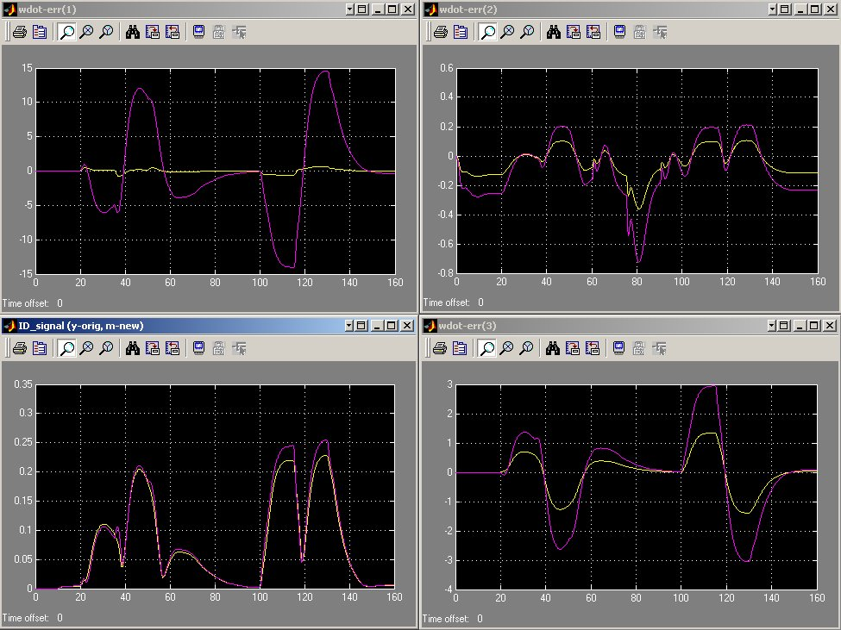
Rud fault: Yel – before scale, Mag – after scale

Slide 57
Small Amp Inputs

Slide 58
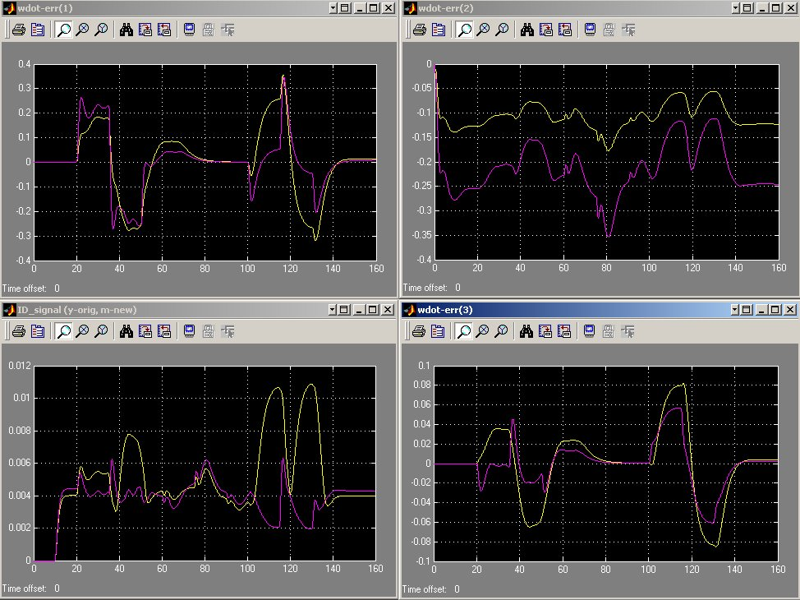
No fault: Yel – before scale, Mag – after scale

Slide 59
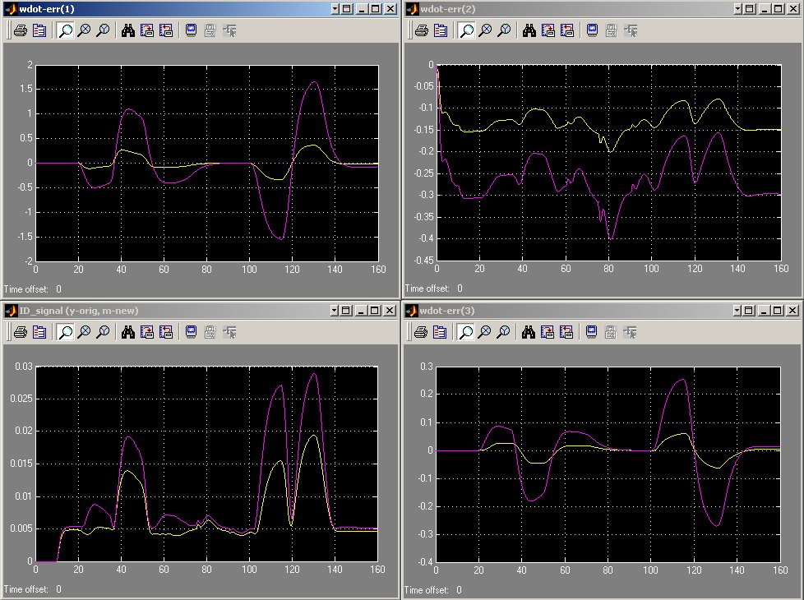
Ail fault: Yel – before scale, Mag – after scale

Slide 60
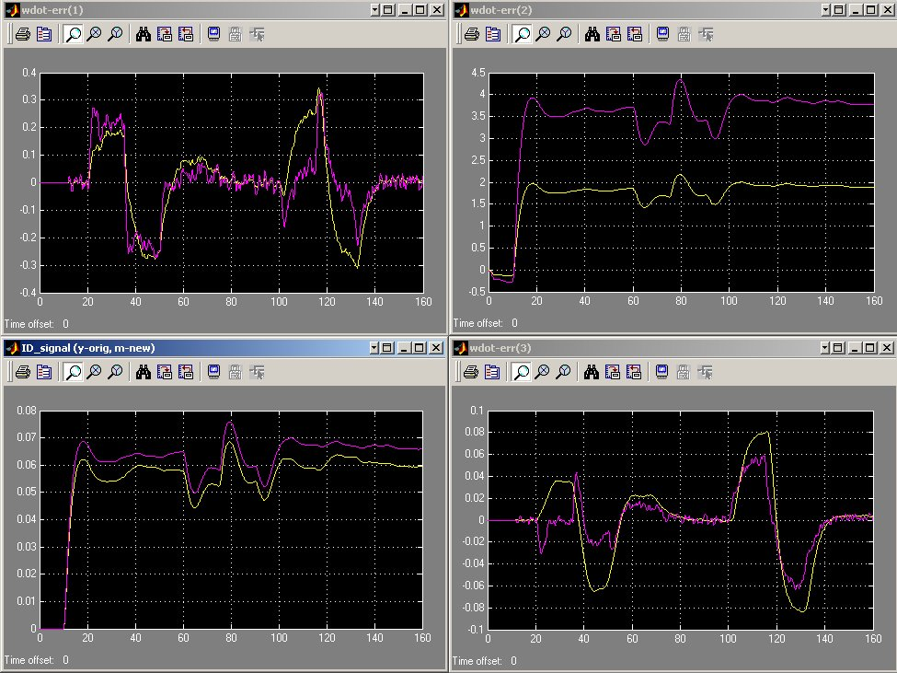
Ele fault: Yel – before scale, Mag – after scale

Slide 61
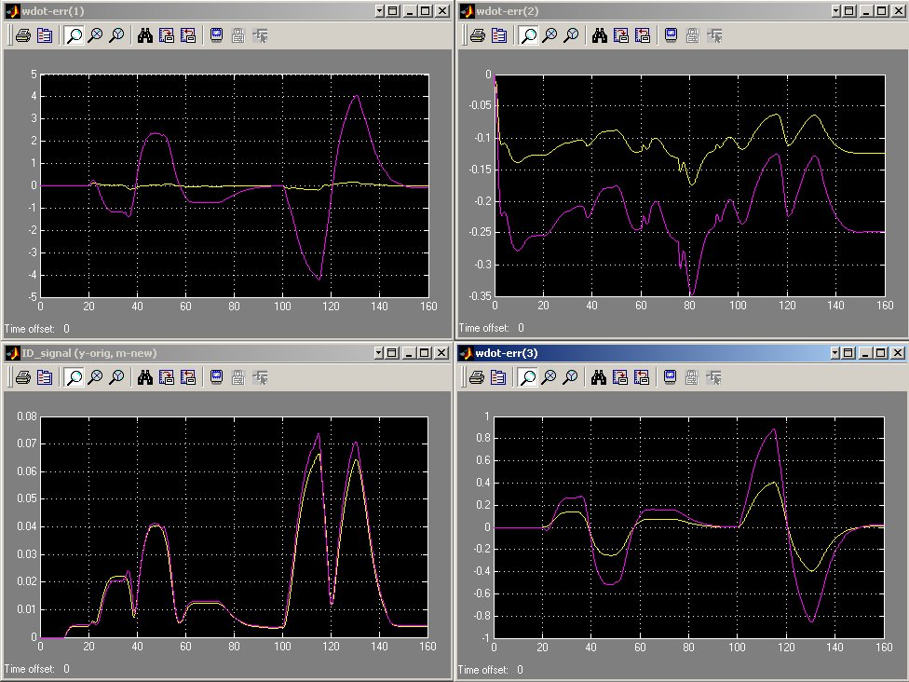
Rud fault: Yel – before scale, Mag – after scale

Slide 62
K-scale Validation
FC2: Boeing 451

Slide 63
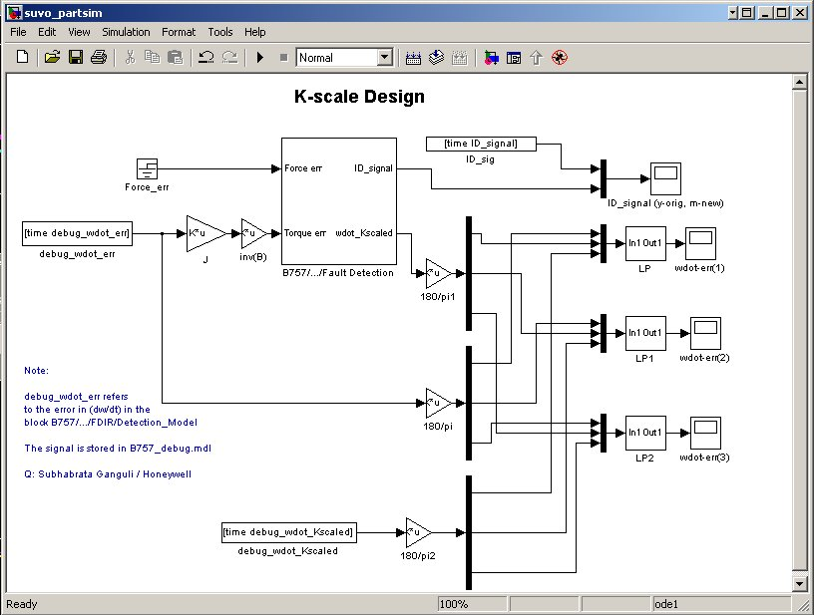
Simulink Block Diagram - Validation

Slide 64
Large Amp Inputs

Slide 65
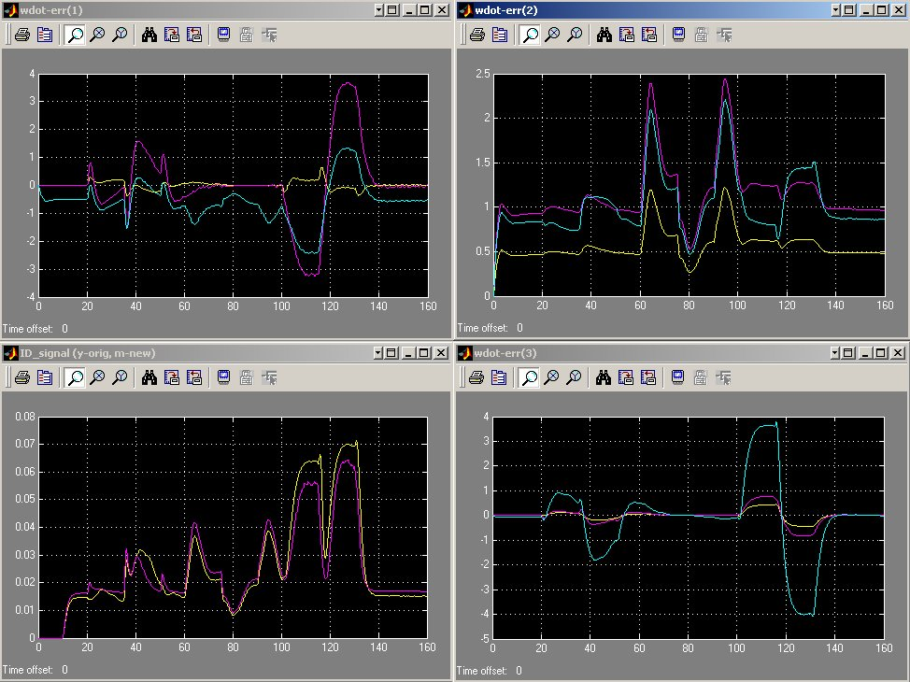
No fault: Yel – before scale, Mag – after scale

Slide 66
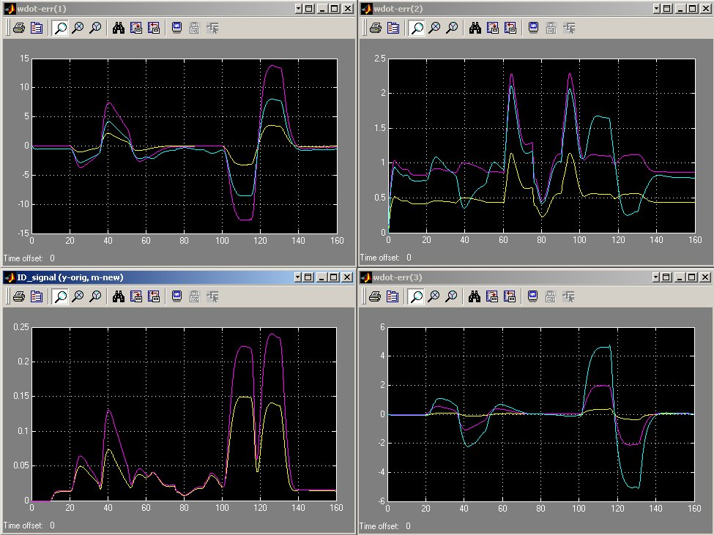
Ail fault: Yel – before scale, Mag – after scale

Slide 67
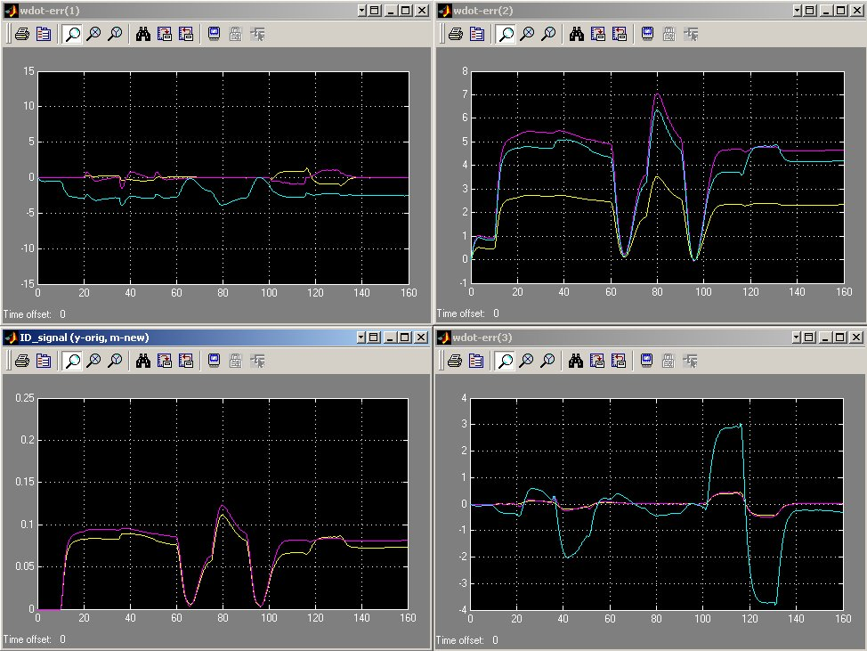
Ele fault: Yel – before scale, Mag – after scale

Slide 68
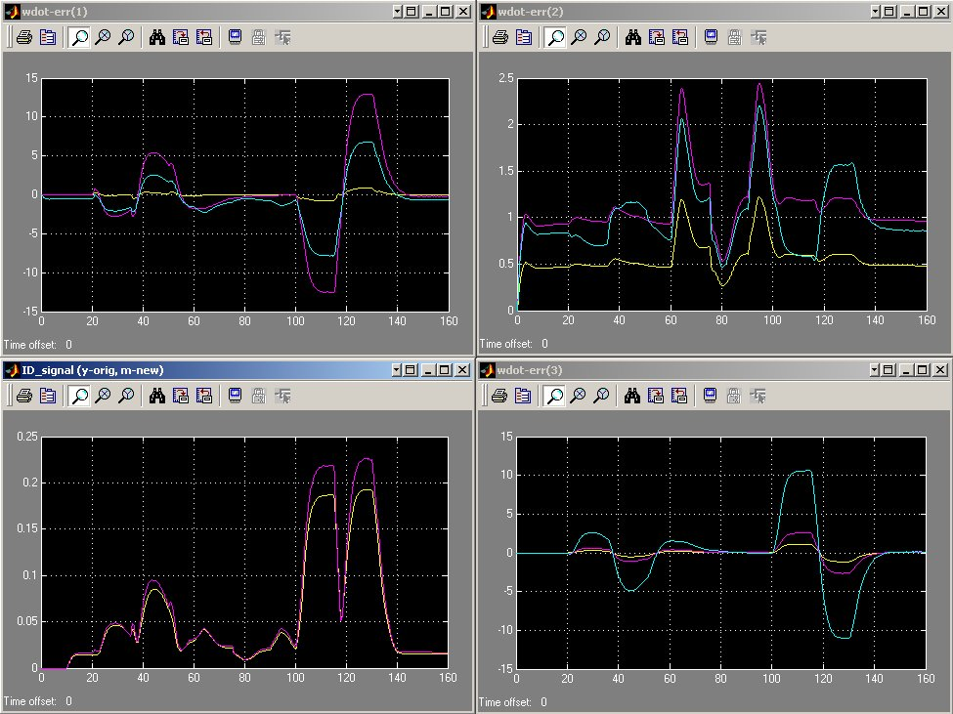
Rud fault: Yel – before scale, Mag – after scale

Slide 69
Small Amp Inputs

Slide 70
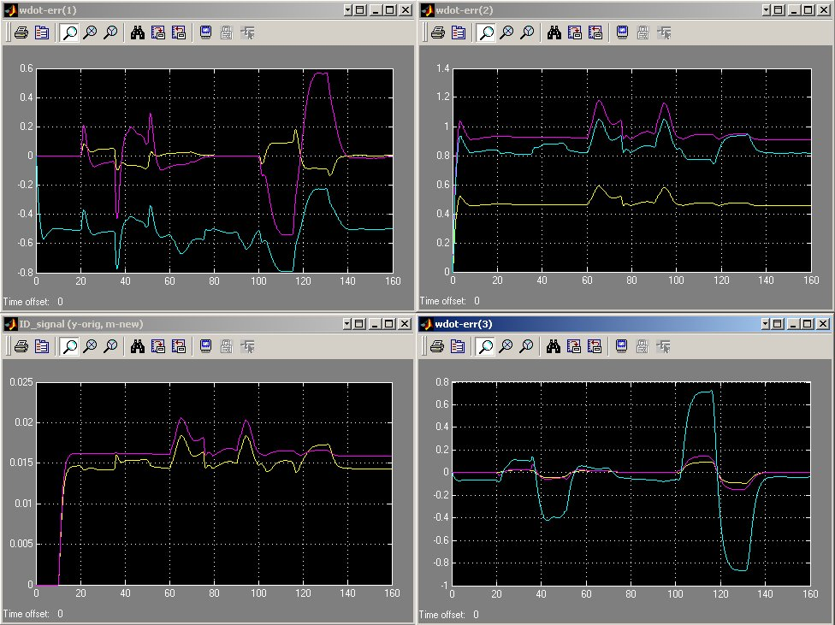
No fault: Yel – before scale, Mag – after scale

Slide 71
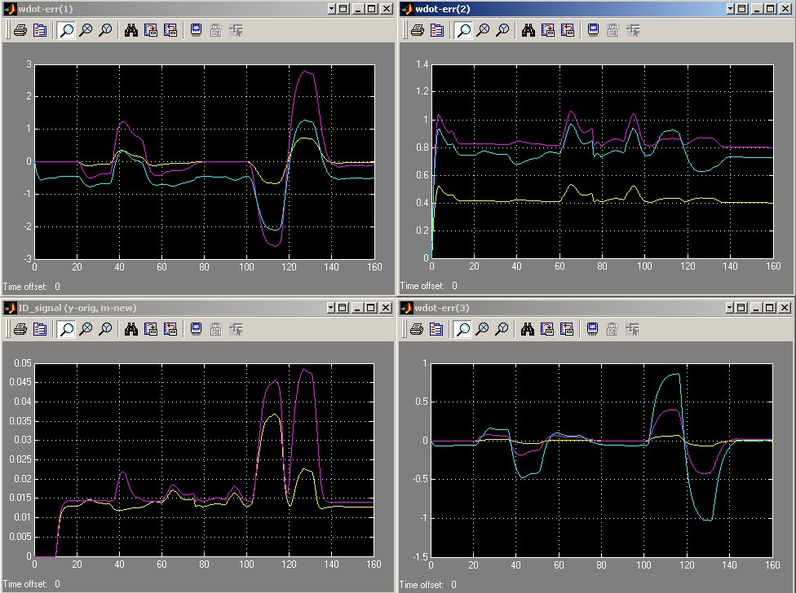
Ail fault: Yel – before scale, Mag – after scale

Slide 72
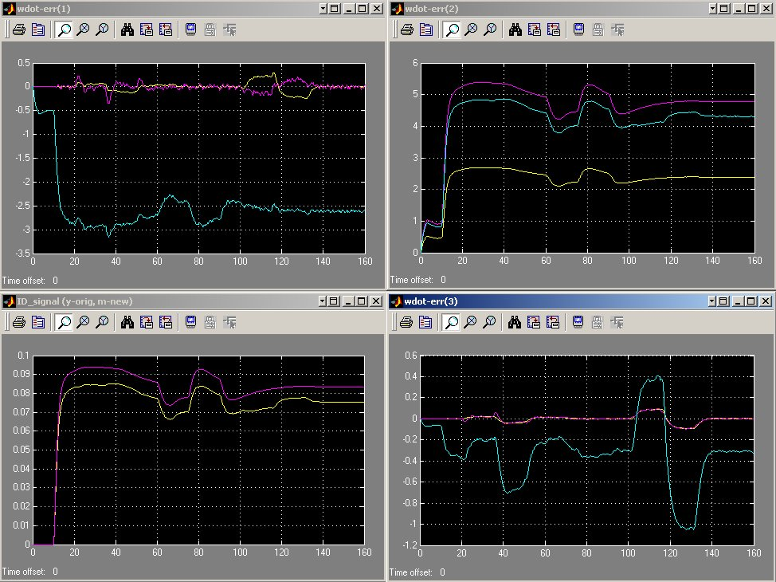
Ele fault: Yel – before scale, Mag – after scale

Slide 73
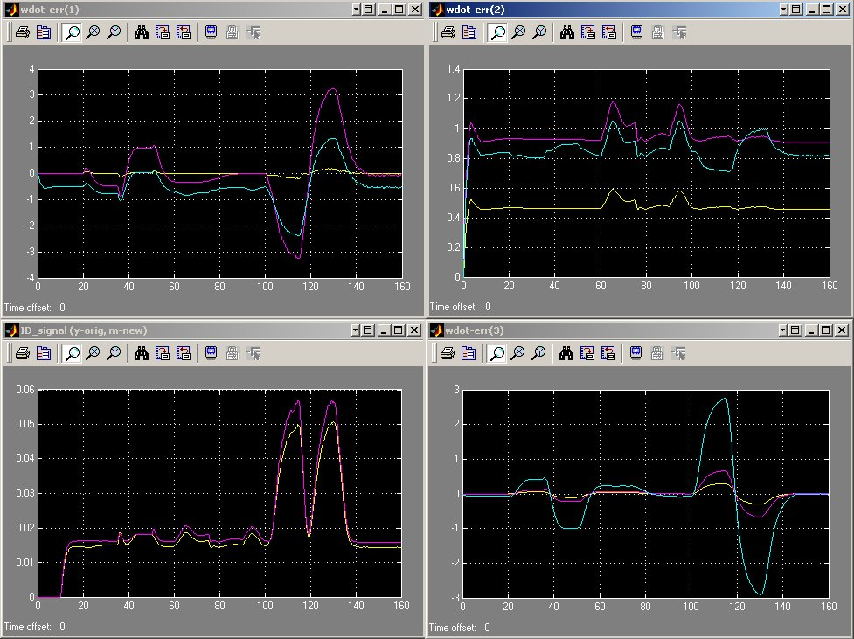
Rud fault: Yel – before scale, Mag – after scale

